Slide 1
The ACM 10th International Conference on Web Intelligence, Mining and Semantics (WIMS ’20), June 30 – July 3, 2020, Biarritz, France
The ICARUS ONTOLOGY:
A general aviation ontology developed using a multi-layer approach
Dimosthenis Stefanidis, Chrysovalantis Christodoulou, Moysis Symeonidis, George Pallis, Marios D. Dikaiakos, Loukas Pouis, Kalia Orphanou, Fenareti Lampathaki, Dimitrios Alexandrou
dstefa02@cs.ucy.ac.cy

Slide 2










Aviation Industry
More than 98 million terabytes of data by 2026¹
4.1 billion passengers and 56.1 million tones of freight were carried in 2017²
Aviation Data
Airlines
Airports
¹ www.flightglobal.com/news/articles/insight-from-flightglobal-the-big-data-landscape-446681
² https://www.icao.int/annual-report-2017/Pages/the-world-of-air-transport-in-2017.aspx

Slide 3
Aviation Data
Complex
Derive from heterogeneous data sources
Lack of standardization
Data integration and linking challenge
Varying data formats
A significant bottleneck with huge cost
“One of the biggest challenges is to integrate the different data silos, for example weather data, live airspace usage or data from the airports. There is really no standard and that complicates things. Even internally we are still merging different data sets from different areas in the company. Insights emerge when you put different departmental data sets together, but at the moment, it is not a smooth process.”
By Rey-Villaverde (Head of Data Science, EasyJet)

Slide 4
Data Integration Problem
With no common standard, aviation data models can vary along various dimensions!
Data providers can use different formats to encode aviation data e.g. an airline carrier ID field could be stored as a three (IATA) or four-letter code (ICAO)
Field names assigned to values can be misleading e.g. a provider may use the name "AT" while another may use "arrTime" for the field "aircraft arrival time"
Even if two data fields are identical, that doesn't ensure that the data represents the same information e.g. the "aircraft arrival time“ may correspond to a scheduled or an actual arrival time.
Data values may be recorded at different temporal frequencies (e.g. once per hour) or spatial regions (e.g. airspace sectors, geographic regions)
Measurement units are often omitted in the data storage schemes and can lead to problems when different units are employed across different systems (e.g. metric vs imperial, feet vs flight level)

Slide 5
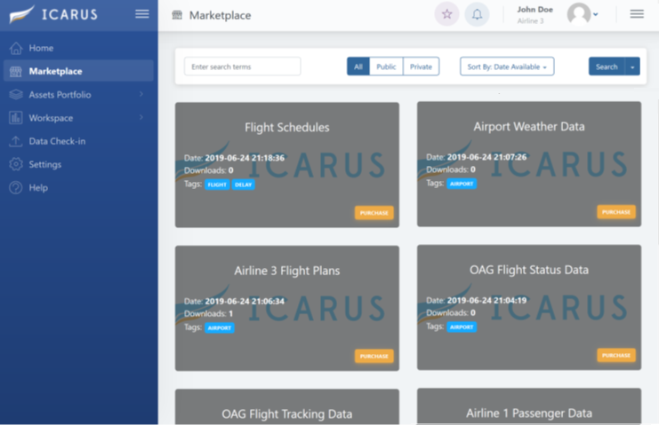
ICARUS Platform
A novel Big Data platform to deal with the data integration challenges in the aviation
Allows exploration, sharing, trading, curation, integration and deep analysis in a trusted manner
Original and derivative data, characterized by different volume, velocity and variety
www.icarus2020.aero

Slide 6
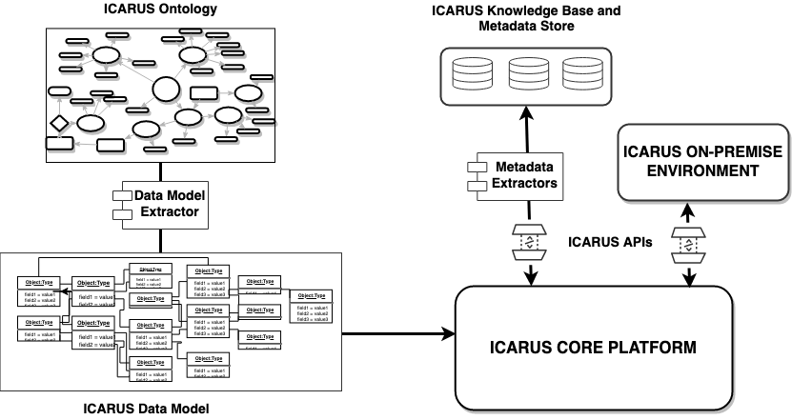
The ICARUS Ontology

Slide 7
The ICARUS Ontology
Represents meaningfully entities of the ICARUS Platform e.g. datasets, algorithms, services (a combination of data and ML algorithms), usage statistics, registered experts etc.
Captures structural and semantic characteristics of entities by using semantic annotation of datasets
Extracts metadata from ICARUS Platform operations to construct the ICARUS knowledge-base
Supports continuous integration of new datasets, services, and users into the platform
Supports search, query and linking over multiple data sources and information assets
Feeds the ICARUS recommendation engine with useful information

Slide 8
ICARUS Ontology - A Multi-layer Approach
Top-level ontology for the
metadata of entities
Meta Contexts
and attributes
(top-level ontology related to metadata
of entities)
C
C₂
C₄
Domain-specific context and attributes
(domain ontologies related to aviation)
C₁
C₃
Weather
Airport
Aircraft
…
Passenger
Flight
Health

Slide 9
ICARUS Ontology - Design Process
Create a top-level ontology for describing platform’s concepts
Integrate
existing aviation domain ontology (e.g. NASA ontology¹)
Capture important concepts, relationships and data fields from aviation stakeholders’ data
Expand
the domain-level ontologies
Ontology Coding Based on a formal language (OWL) using Protégé.
¹ Keller, R. M. (2016, September). Ontologies for aviation data management. In 2016 IEEE/AIAA 35th Digital Avionics Systems Conference (DASC) (pp. 1-9). IEEE.

Slide 10
Class Hierarchy

Slide 11
Class Hierarchy

Slide 12
Class Hierarchy

Slide 13
Class Hierarchy

Slide 14
Class Hierarchy

Slide 15
Possible competencies questions that ICARUS Ontology can answer
‘‘Which datasets contain columns about flight delay time?’’
‘‘Which is the airport departure terminal for a specific flight?’’
‘‘How many were the occupied seats on a specific flight?’’

Slide 16




Use Cases
Twitter
Recommendation System
Covid-19

Slide 17
Scenario: Twitter
Based on Twitter data (e.g. travelers' tweets) that are related to the aviation, the popularity (e.g. sentiment score) of airlines and airports can be found and extracted.
Providing such kind of statistics (e.g. popularity) could help airlines to find:
the most common problems in case of bad flight e.g. late flight, long lines, lost luggage, customer service, etc.
popularity of one airline versus competitors

Slide 18
Scenario: Twitter
Ontology Extension: expand the ICARUS ontology based on the concepts and entities related to Twitter e.g. twitter user account, the number of followers, tweets, etc.
Data Collection: retrieve tweets and airlines accounts via the Twitter Streaming API
Data Pre-processing: apply data cleaning and natural language processing (NLP) techniques to the retrieved tweets

Slide 19
Scenario: Twitter
Emotions Extraction: perform sentiment analysis (e.g. VADER) on a set of retrieved tweets, by including emotion categories in the ontology
Storage: store to the ICARUS ontology (knowledge base)
Query KB: Use SPARQL queries to answer possible questions of ICARUS users
e.g. "Which airline has the lowest popularity?" (searching for the entity airline with the most negative sentiment based on the stored aggregated statistics)

Slide 20
Scenario: Recommendations
Provide high-quality recommendations of datasets and services to the ICARUS users by utilizing the ICARUS ontology.
We can recommend assets that are connected indirectly to the user’s preferences and needs by:
capturing structural and semantic characteristics of the various ICARUS entities
inferring relationships (e.g. inheritance) between users and assets that were hidden

Slide 21
Scenario: Recommendations
Data Collection: retrieve data related to users and assets of the ICARUS platform (e.g. preferences, interactions like purchases with datasets and services, metadata of datasets, etc.).
Storage: store to the ICARUS ontology (knowledge base)
Reasoning: apply a reasoning algorithm (Pellet) to reveal hidden relationships (e.g. inheritance)

Slide 22
Scenario: Recommendations
Recommender: Use a weighted-based hybrid recommendation system approach to provide recommendation of datasets and services to each user
Content-Based: Use SPARQL queries to retrieve users’ preferences, geolocation and organization types with the respective information of the given datasets and services
Collaborative Filtering: Use SPARQL queries to retrieve the interplay between users and assets to construct the interaction matrix

Slide 23
Scenario: COVID-19
Current challenges of health organizations: locate, collect, explore and integrate reliable data about airline and human mobility, with a sufficient geographical coverage and resolution.
Improving such level of detail would result:
in more accurate epidemic predictions and
a possible estimation of relative revenue losses to be expected in different pandemic scenarios

Slide 24
Scenario: COVID-19
The ICARUS ontology and the relationships between each entity can be utilized to combine epidemics data with other aviation-related data for data analytics and epidemic forecasts.
Ontology Extension: expand the ICARUS ontology based on the concepts and entities related to COVID e.g. mortality rate, cases per city/country, etc.
Data Collection: retrieve open data related to COVID-19 and aviation data

Slide 25
Scenario: COVID-19
Storage: store to the ICARUS ontology (knowledge base)
Query KB: Use SPARQL queries, aviation-related data and COVID-19 data to answer possible questions of ICARUS users
e.g. "Which datasets can help me predict a virus transmission from incoming flights?" (Find datasets that are related to incoming flights and virus and they are utilized by forecasting services for virus transmission)

Slide 26
Conclusion
We presented the ICARUS ontology, an aviation domain ontology designed using a multi-layer approach for enabling:
the integration and reasoning over multiple sources of heterogeneous aviation-related data
the semantic description of metadata produced by the ICARUS platform
Main strengths of the proposed ontology:
extendibility and interoperability due to the multi-layer design
ease of use on multiple aviation data sources of different format and structure

Slide 27



Thank You! The ontology is available here (open source): https://github.com/UCY-LINC-LAB/icarus-ontology
Co-funded by the European Commission Horizon 2020 - Grant # 780792

